Slide 1
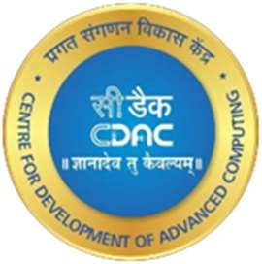
Center for Development of Advanced Computing - Patna
Project Title
TEXTILE SUPPLY CHAIN MANAGEMENT USING HYPERLEDGER FABRICS
By
PARAS MANCHANDA (220980742009)
PRASHANT PANDEY (220980742011)
RAM GAWAS (220980742004)
GUIDED BY
Mr. DEAVYANSH GAUTAM
FINTECH AND BLOCKCHAIN DEVELOPMEMT

Slide 2
TOPIC
Textile Supply Chain Management System using Hyperledger Fabrics

Slide 3
What is Textile Supply Chain Management
Textile supply chain management refers specifically to the management of the supply chain within the textile industry.
The textile industry involves the production, manufacturing, and distribution of textile products, such as fabrics, yarns, and finished products like clothing and home textiles.

Slide 4
Challenges in Textile Industry
The textile industry is a complex and global supply chain involving multiple stakeholders such as manufacturers, suppliers, and retailers.
This complexity can lead to challenges in managing the supply chain, such as lack of transparency, inefficient processes, and difficulties in tracking the movement of raw materials and finished products

Slide 5
Why Hyperledger Fabrics used ?
Hyperledger Fabric, a permissioned blockchain framework, is particularly suited for supply chain management due to its privacy and permission features.
In this paper, we propose a Textile Supply Chain Management System using Hyperledger Fabric. The proposed system will enable companies in the textile industry to track the provenance of raw materials, such as cotton or wool, from the farm to the factory, and ultimately to the finished product. This will ensure the ethical sourcing of materials and provide customers with transparent information about the products they are buying.

Slide 6
Problem Statement
Problem Statement: Inefficient supply chain management leading to high lead times, high costs, low transparency, and poor-quality control in the textile industry.
The textile industry involves multiple stakeholders, including suppliers, manufacturers, distributors, and retailers, making the supply chain complex and fragmented.
The supply chain management in the textile industry is often inefficient, leading to long lead times, high costs, low transparency, and poor-quality control.

Slide 7
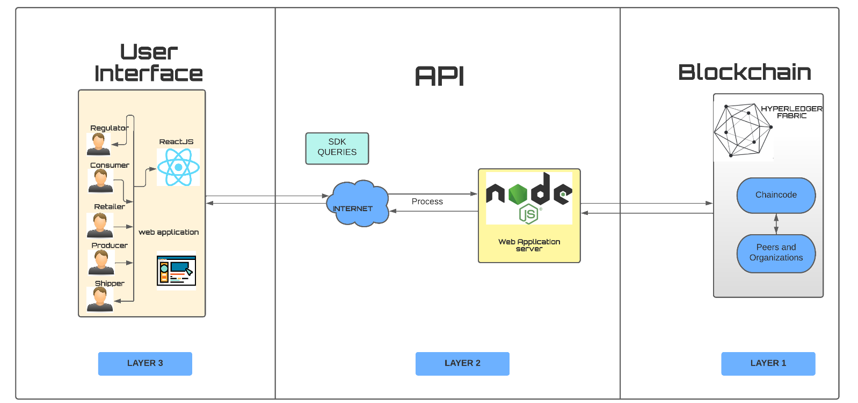
Architecture
Hyperledger Fabric Blockchain framework,
Nodejs frontend and backend (blockchain) to communicate together,
Database CouchDB.
React is used for developing the Web UI

Slide 8
Methodology / Techniques
The proposed Textile Supply Chain Management System using Hyperledger Fabric will utilize several key techniques and methodologies to ensure efficient and secure data sharing among the stakeholders in the supply chain.
Hyperledger Fabric Framework: The proposed system will be built on the Hyperledger Fabric framework, which is a permissioned blockchain framework designed for enterprise use. Hyperledger Fabric provides features such as private channels, smart contracts, and consensus protocols that are essential for supply chain management.

Slide 9
Cont…..
Smart Contracts: Smart contracts will be used to automate and execute the business logic of the proposed system. This will ensure that transactions are executed correctly and transparently among the stakeholders in the supply chain.
Private Channels: Private channels will be used to enable secure and confidential data sharing among the stakeholders in the supply chain.
Consensus Protocols: Consensus protocols will be used to ensure that all participants in the supply chain agree on the state of the ledger. This will ensure that transactions are executed correctly and transparently.
Integration with Existing Systems: The proposed system will be designed to integrate with existing systems used by the stakeholders in the supply chain. This will ensure that the proposed system can be easily adopted and integrated into the existing supply chain infrastructure.

Slide 10
Cont….
User Interface: The proposed system will have a user interface that will enable the stakeholders in the supply chain to Easily access and interact with the system. The user interface will be designed to be user-friendly and intuitive.
Overall, the proposed Textile Supply Chain Management System using Hyperledger Fabric will utilize several key techniques and methodologies to ensure efficient and secure data sharing among the stakeholders in the supply chain. These techniques and methodologies will be essential for ensuring the success of the proposed system and its adoption by the textile industry.

Slide 11
Hyperledger Fabric Blockchain framework,
Hyperledger Fabric is a permissioned blockchain framework designed to be modular and scalable for enterprise use cases. Its architecture is based on a distributed system of nodes that communicate and reach consensus on transactions through a consensus protocol.
Here is a brief overview of the architecture of Hyperledger Fabric:
Peer nodes:
Orderer nodes:
Membership service provider (MSP):
Chaincode:.
Channels:
Ledger

Slide 12
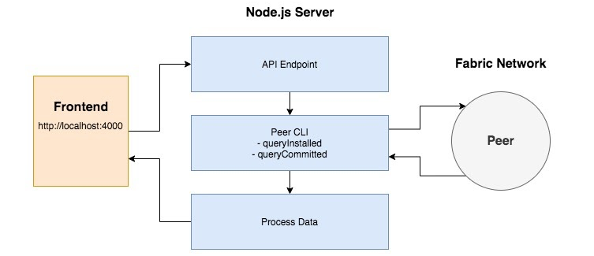
Nodejs frontend and backend (blockchain) to communicate together
In order to enable communication between a Node.js frontend and backend for a blockchain application, there are a few steps that need to be taken.
Setting up a Node.js backend: The first step is to set up a Node.js backend that will communicate with the blockchain. This can be done using a blockchain SDK or API, such as the Hyperledger Fabric Node.js SDK.
Creating an API.
Connecting the frontend to the backend:
Handling responses:
Authenticating users:
.
Overall, the key to enabling communication between a Node.js frontend and backend for a blockchain application is to use a well-defined API and HTTP client library to send requests and receive responses.

Slide 13
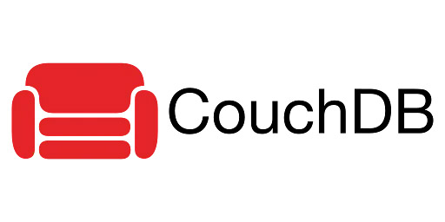
DATA BASE COUCHDB
COUCHDB
CouchDB is a NoSQL database management system that uses a document-oriented model to store data. It is open-source, highly scalable, and designed for distributed environments.
Some key features of CouchDB include:
Schema-less data model
Replication and synchronization
MapReduce:
RESTful API:
Security:

Slide 14
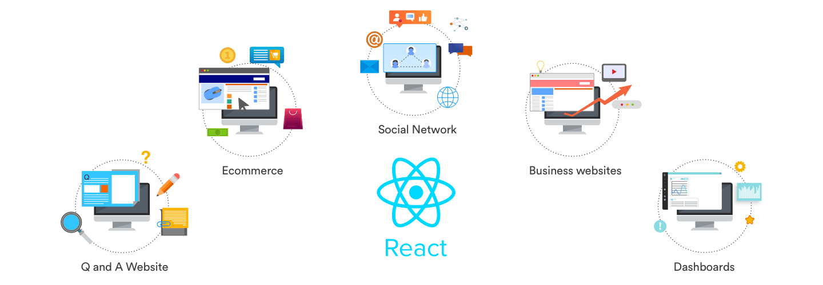
React is used for developing the USER-INTERFACE
React is a popular JavaScript library used for building user interfaces and web applications. It was developed by Facebook and has become widely adopted by developers due to its simplicity, flexibility, and performance.
Component-based architecture
Virtual DOM
Performance
JSX
Large community

Slide 15
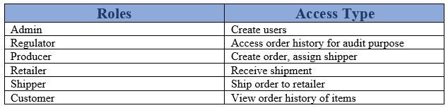
STAKE HOLDERS
Retailer
Producer
Shipper
Customer
Regulator
Overall, these stakeholders have different roles and interests in the supply chain, but all of them have a common interest in ensuring that the products being produced and transported are of high quality and meet regulatory standards. The blockchain application provides transparency and accountability throughout the supply chain, which benefits all stakeholders involved.

Slide 16
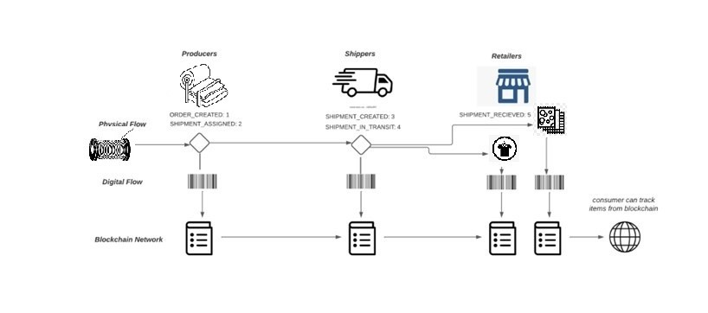
IMPLIMENTATION
State diagram
A textile supply chain management system typically involves the following flow:
In a textile supply chain management system, each entity can track the movement of the fabric or finished products from one entity to another using a blockchain-based platform. This platform can capture and store data about the product, including its origin, quality, and journey through the supply chain. This enables transparency, traceability, and accountability in the supply chain, and helps to prevent issues such as fraud, and unethical practices.

Slide 17
Network Setup
1-Fabric set up 15- Order History
2- Adding Organisation 16- To Run Server Side
3-Generate Organisation Config 17- To Run Client Side
4- Starting docker Container
5- Deploy chain code
5- Setting Environment variables
6- Accessing CouchDB interface
7- Initialize Chain-Code
8- Interact with chain code
9- Create Product
10- Assign Shipper
11- Create Shipment
12- Transport Shipment
13- Receive Shipment
14- Select by ID

Slide 18
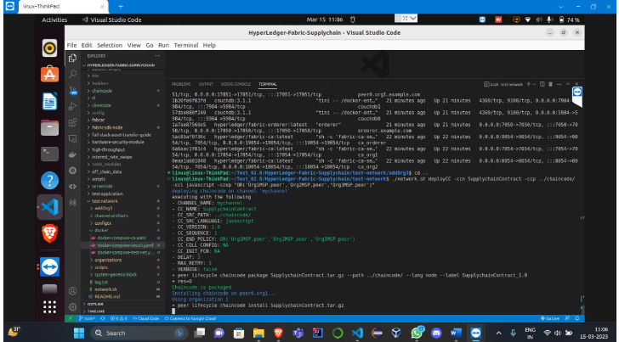
CHAIN-CODE DEPOYMENT
Chain code Deployment -Chain code deployment refers to the process of installing and instantiating smart contracts (chain code) onto a blockchain network. Chain code is the code that defines the rules and logic governing a blockchain network, and it is executed by the nodes on the network.

Slide 19
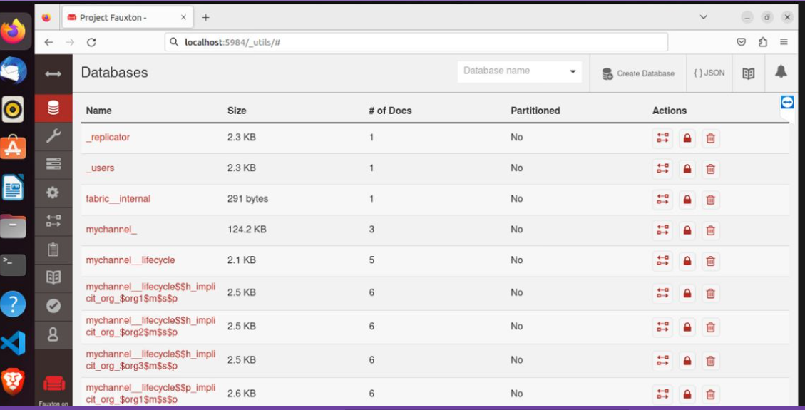
DATBASE –RESULTS
DATA-BASE RESULTS

Slide 20
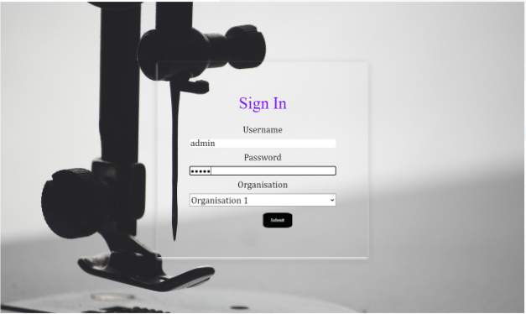
USER-INTERFACE
React front-end UI: The application uses React to create a user-friendly front-end UI that allows users to interact with the blockchain ledger, query data, and view order history.

Slide 21
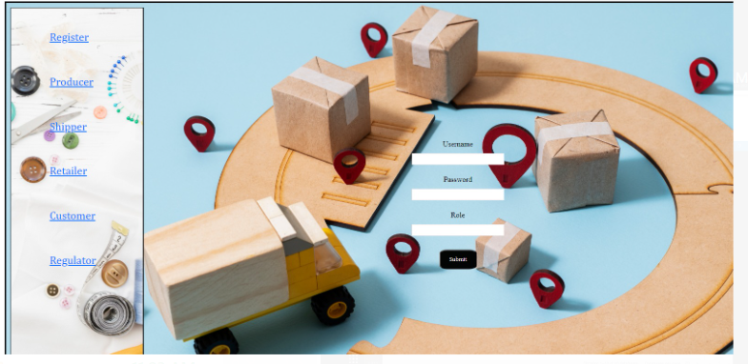
Cont……
LOGIN PAGE FOR USERS && ADMIN

Slide 22
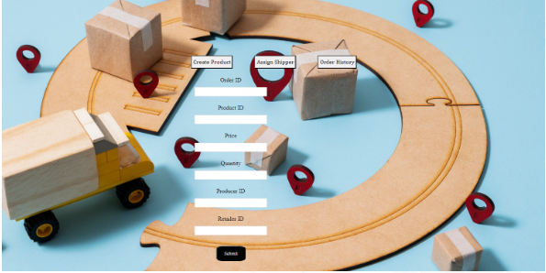
CON……
Details to be entered

Slide 23
Results & Conclusion
In conclusion, the implementation of a Textile Supply Chain Management System using Hyperledger Fabric has several benefits. Hyperledger Fabric provides a secure, permissioned blockchain network that enables secure and transparent communication between all parties in the supply chain. By using a blockchain-based solution, all parties can access the same data in real-time, which can improve communication, reduce errors, and increase efficiency.
.
Overall, a Textile Supply Chain Management System using Hyperledger Fabric has the potential to revolutionize the textile industry by providing greater transparency, security, and efficiency. By implementing a blockchain-based solution, the industry can improve supply chain management, reduce costs, and enhance customer satisfaction.

Slide 24
References
https://youtu.be/8tVx0r6pgU4
https://medium.datadriveninvestor.com/hyperledger-fabric-best-practices-in-production-1-encrypting-state-database-with-chaincode-8369b0bc345a
https://medium.com/zeeve/crucial-considerations-before-deploying-hyperledger-fabric-in-the-blockchain-network-in-2023-5ac2cdad1be9
https://hyperledger-fabric.readthedocs.io/en/release-2.5/test_network.html
https://hyperledger-fabric.readthedocs.io/en/release-2.5/glossary.html
https://hyperledger-fabric.readthedocs.io/en/release-2.5/getting_started.html
https://www.sellbrite.com/blog/quick-guide-product-shipping-everything-need-know/
https://images.app.goo.gl/VfRBL3uNTS26cVuU9

Slide 25
THANK-YOU FOR YOUR PATIENCE

